Slide 1


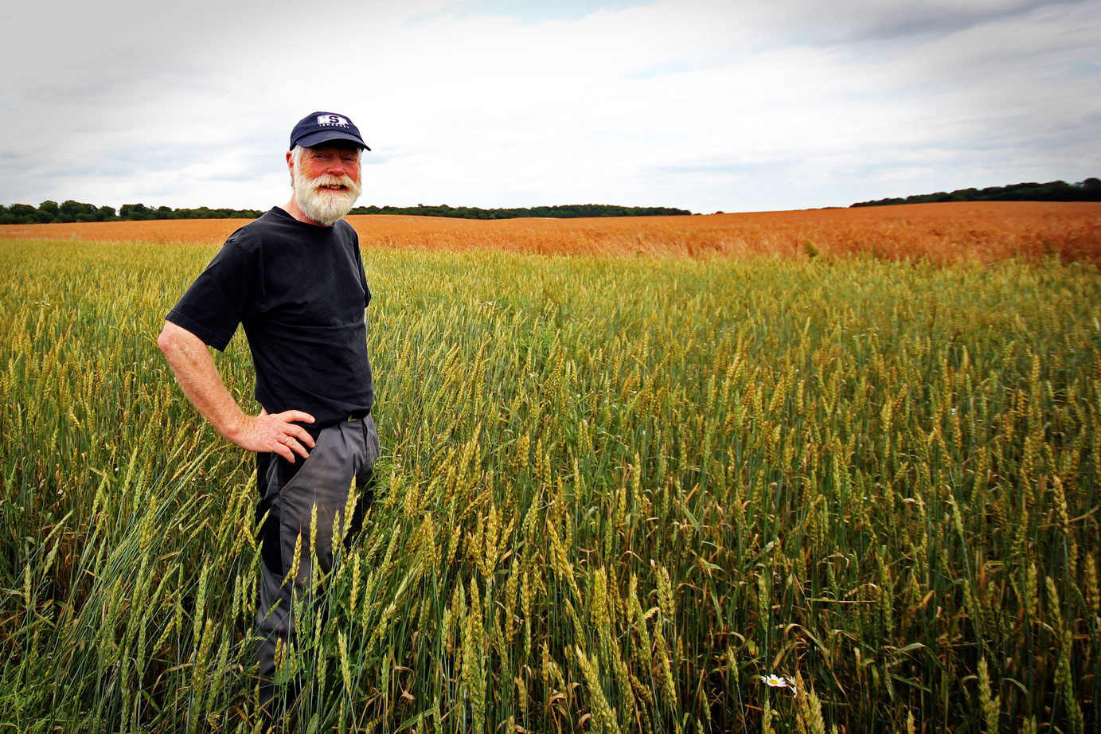

SOIL FERTILITY PREDICTION
USING MACHINE LEARNING
Submited By : HARSHIT KUMAR SAHU
Class : MCA 4th Semester
Roll No. : 21072123
Enrollment No. : GGV / 21 / 02050
Guided By : Dr. AMIT KUMAR CHANDANAN
(Associate Professor)

Slide 2


INTRODUCTION
Machine learning with soil fertility
Soil fertility is vital for robust plant growth, crop yield, and sustainable agriculture, sustainable food production. Our focus today is on leveraging predictive models to enhance soil fertility. By harnessing data-driven insights
Harnessing the power of machine learning, we aim to revolutionize how we manage soil fertility. By developing predictive models, we strive to optimize nutrient allocation.

Slide 3
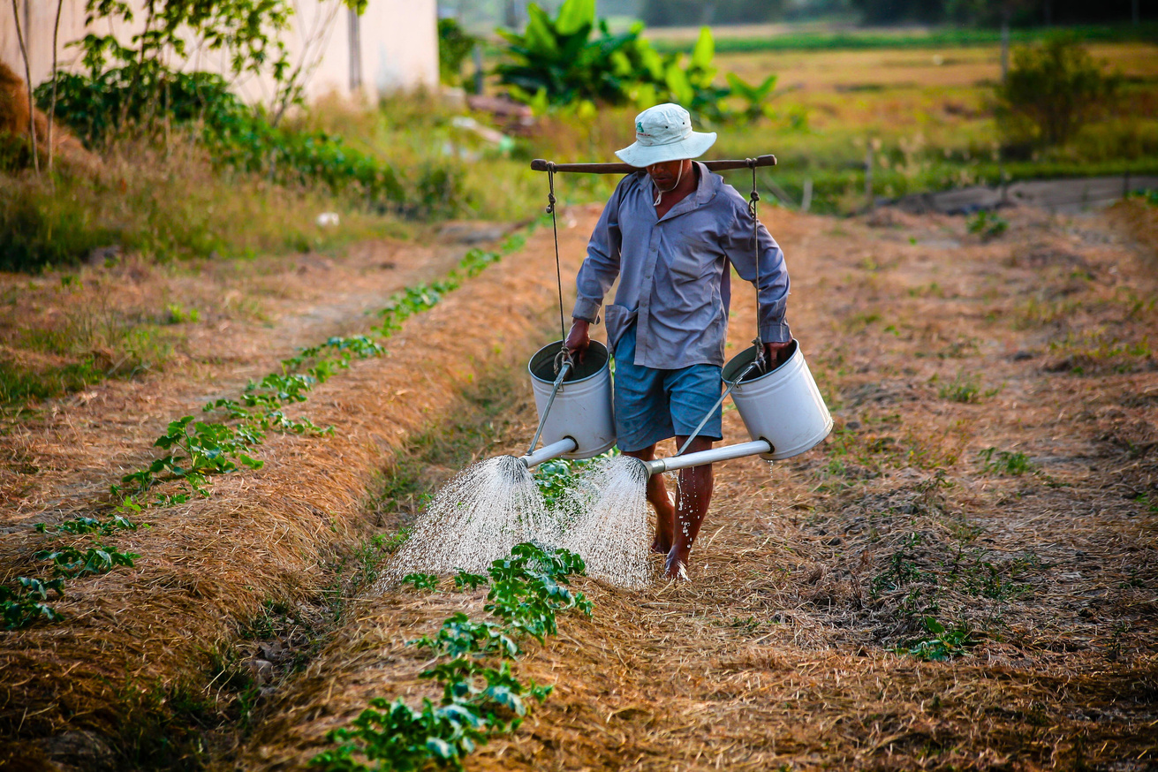

IMPORTANCE OF SOIL FERTILITY
Soils support 95% of all food production.
It takes 2,000 years for natural processes to make 10 centimeters of fertile soil from bedrock.
.
The main function provided by a fertile soil is the provision of food, which is very important considering FAO's Zero hunger objective. A fertile soil also provides essential nutrients for plant growth, to produce healthy food with all the necessary nutrients needed for human health.

Slide 4
ELEMENTS NEEDED FOR FERTILE SOIL
N = Nitrogen
P = phosphorous
K = Potassium
Ph = A scale used to identify acid or base nature
EC = Electrical Conductivity
OC = Organic Carbon (Urea)
S = Sulphur
zn = zinc
Fe = iron
Cu = Copper
Mn = Magnesium
B = Boron
The mentioned chemicals and parameters are crucial indicators of soil fertility and quality. By collecting data on these parameters from various soils and sources, we can build a comprehensive dataset. This dataset can then be utilized to develop a machine learning prediction model.

Slide 5
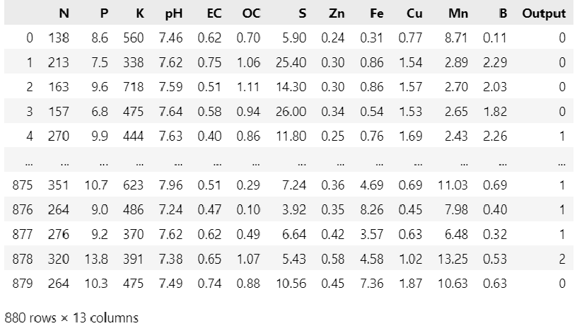
Dataset Scource
Data collection is the initial and crucial step in building a successful soil fertility prediction model.
High-quality, relevant data serves as the fuel that powers machine learning algorithms, enabling them to make accurate predictions.
Dataset for research is provided by : https://www.kaggle.com/datasets/rahuljaiswalonkaggle/soil-fertility-dataset & IGKV(Indra Ghandi Krishi vishwavidyalaya), Raipur.
Step Number #1
Step Number #2
DATA PRE-PROCESSING
DATA SPLITTING

Slide 6

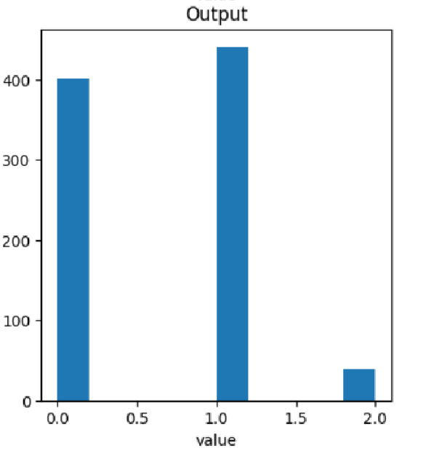

DATA PRE-PROCESSING
Harvest And Farming Life In Great World
During the Data Visualization we found that the Output Field is Unbalanced, the output of Average, Good and Best Soil is represented with 0,1 and 2. As we see the frequency of Best Soil in our Data set is low which could Lead our Machine Learning Model to Under fitting due to which Trained model could Result wrong predictions to Overcome this problem we Need to Create Similar data in Comparision of Best Soil data or we can reduce the frequency of other data for Normalization of dataset. to perform the task we used following methods
Under Sampeling
Over Sampeling

Slide 7
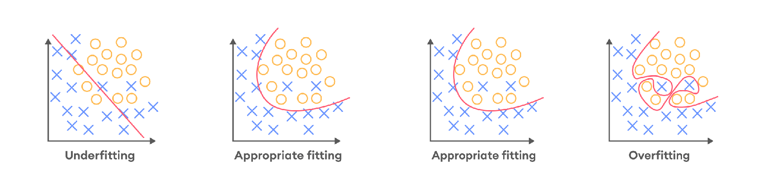
UNDERFITTING
OVERFITTING
Underfitting occurs when a model is not able to make accurate predictions based on training data and hence, doesn’t have the capacity to generalize well on new data. Another case of underfitting is when a model is not able to learn enough from training data.
A model is considered overfitting when it does extremely well on training data but fails to perform on the same level on the validation data (like the child who memorized every math problem in the problem book and would struggle when facing problems from anywhere else).

Slide 8
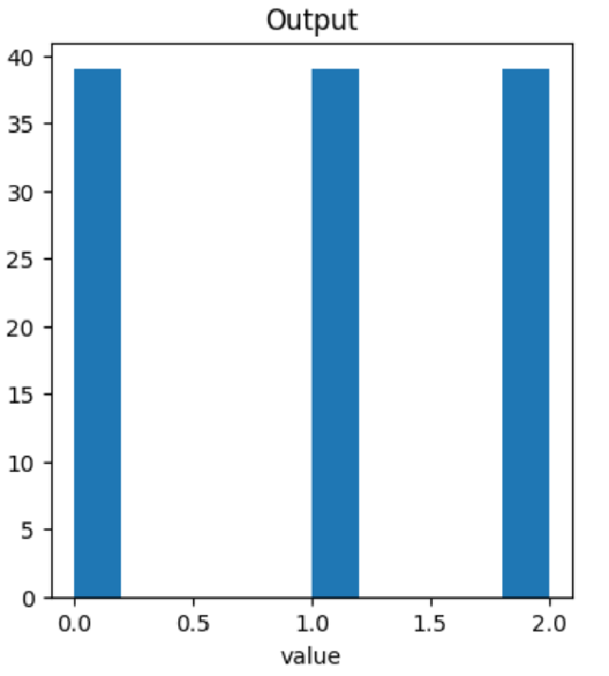


UNDER SAMPELING
Undersampling refers to a group of techniques designed to balance the class distribution for a classification dataset that has a skewed class distribution.
But after Under Sampeling our dataset got small it only contained 117 rows X 13 column which could also lead to
PLOTING BAR GRAPH AFTER UNDER SAMPELING OF DATASET

Slide 9
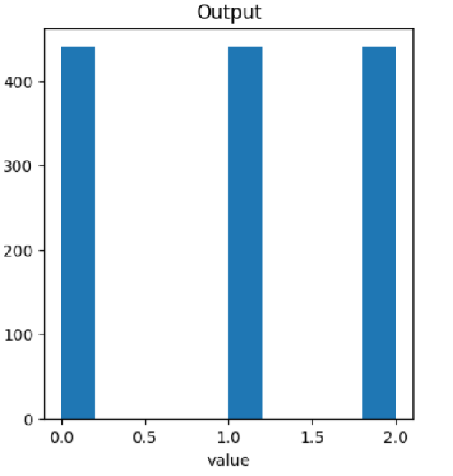

(SMOTE)OVER SAMPELING
SMOTE (Synthetic Minority Over-sampling Technique) is an oversampling technique where the synthetic samples are generated for the minority class. This algorithm helps to overcome the overfitting problem posed by random oversampling. with a data set frequency of 1320 rows X 13 columns.?
PLOTING BAR GRAPH AFTER UNDER SAMPELING OF DATASET

Slide 10
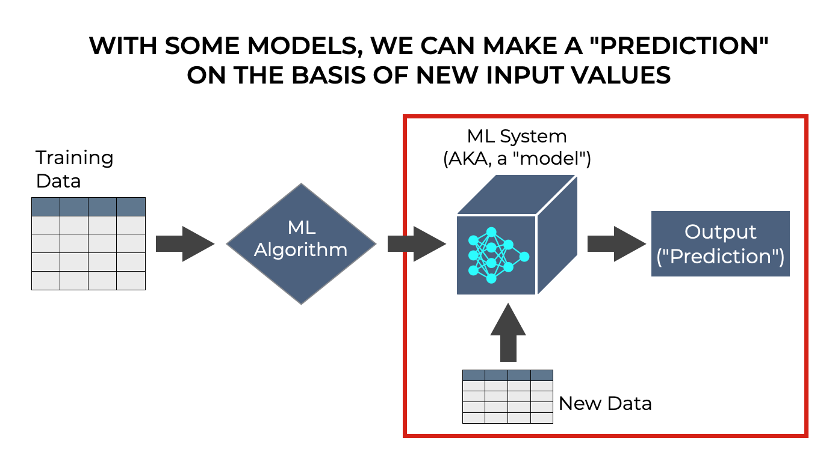
WHAT IS MACHINE LEARNING ?
Machine learning is a part of artificial intelligence where algorithms learn and improve from data instead of explicit programming. It lets computers recognize patterns, predict outcomes, and tackle complex tasks
by adapting to new information. This aids fields like healthcare, finance, and automation by uncovering insights and building predictive models from large datasets. The algorithms continuously enhance accuracy, making machine learning valuable for decision-making across industries.

Slide 11

CLASSIFICATION MODELS USED
Logistic Regression
Random Forest
K-Nearest Neighbour
Decision Tree
Artificial Neural Network
SVM (Support Vector Machine)
XG Boost
Best Quality
Good Seeds
Fertile Land
Good Product
ALL OF THE CLASSIFICATION MODEL PERFORMED WELL WITH DATASET

Slide 12
MODELS ACCURACY
ML MODELS | ACCURACY %NORMAL DATA | ACCURACY %UNDERSAMPELING | ACCURACY %OVERSAMPELING (SMOTE)
Logistic Regression | 87.72% | 63.33% | 72.12%
Random Forest | 45.90% | 36.66% | 30.30%
K-Neatest Neighbors | 80.45% | 63.33% | 77.57%
Decision Tree | 90.45% | 96.66% | 88.78%
Artificial Neural Network | 85.45% | 30% | 52.12%
Support Vector Machine | 83.63% | 63.33% | 88.18%
XG Boost | 89.09% | 86.66% | 94.54%

Slide 13
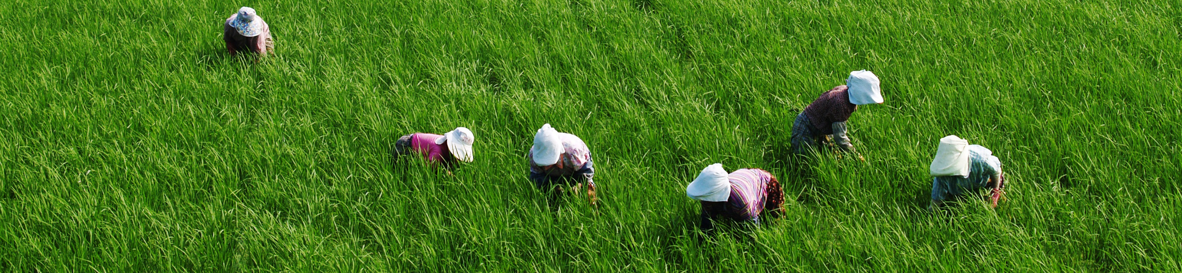
RESULT
As we see the most accuracy is obtained by Decision Tree in undersampeling of dataset but its possibilities of under-fitting is keep occurring in undersampeling dataset so we need to consider the oversampled data where XG Boost model provides 94.54% highest in all of other models so we can consider it .

Slide 14
CONCLUSION
The vast amount of data that is now being collected alongside agricultural crops holds immense potential and must be thoroughly analysed to extract its full value. In my research, I have discovered that XG Boost, with its accuracy of 94.54%, is an excellent choice as a foundational algorithm for predicting soil fertility. By incorporating additional meta-algorithms such as attribute selection and boosting, we can construct a powerful and reliable predictive model. This comprehensive approach harnesses the strength of various techniques to create a highly effective and accurate solution.
BETTER SOIL QUALITY MEANS BETTER FOOD PRODUCTIION BY FARMERS WHICH HELPS PEOPLES BETTER HEALTH.

Slide 15

THANKS FOR
Your Attention
PRESENTED BY:
Submited By : HARSHIT KUMAR SAHU
Class : MCA 4th Semester
Roll No. : 21072123
Enrollment No. : GGV / 21 / 02050

